Slide 1

Green Pace
Security Policy Presentation
Developer: Christian Busca

Slide 2

OVERVIEW: DEFENSE IN DEPTH
[Introduce your security policy. Explain why it was needed and how it will be used to support the defense-in-depth best practice.]

Slide 3
THREATS MATRIX
Priority: Hardcoded credentials and weak encryption are catastrophic if exploited, so they must be fixed first. Dependencies must be patched to remove known CVEs.
Likely: Common flaws like injection, buffer overflows, and poor input validation are frequently exploited by attackers and therefore high risk.
Low Priority: Error handling, file access, and logging don’t directly lead to breaches, but they weaken defenses and incident response if ignored.
Unlikely: Race conditions occur less often, but if they do, they can lead to privilege escalation or data corruption.
SQL Injection Buffer Overflow Weak Input Validation | Hardcoded Credentials Weak/Improper Encryption Unpatched Dependencies
Improper Error Handling Insecure File Handling Insufficient Logging | Race Conditions

Slide 4
10 PRINCIPLES
Validate Input — assume all input is hostile; validate, sanitize, canonicalize. Applies: STD-001 (input validation), STD-002 (bounds checking), STD-003 (injection-safe data access)
Least Privilege — give code, users, and processes only what they need. Applies: STD-004 (secrets mgmt; no hardcoded creds), STD-006 (file perms/allowlists), STD-007 (concurrency/lock down shared resources)
Fail Securely — on errors, default to secure behavior and reveal nothing sensitive. Applies: STD-005 (secure error handling)
Defense in Depth — layered controls so one failure doesn’t doom the system. Applies: STD-008 (crypto policy), STD-009 (dependency/patch hygiene), STD-010 (logging/monitoring)
Separation of Duties — split responsibilities to reduce abuse and mistakes. Applies: STD-007 (safe concurrency/role separation in code paths), STD-010 (independent audit trail)
Minimize Attack Surface — expose the fewest inputs, features, and permissions possible. Applies: STD-001 (reject bad input early), STD-002 (prevent memory overreach), STD-006 (restrict file I/O), STD-009 (remove vulnerable/unused deps)
Secure Defaults — deny-by-default, opt-in to risk, ship hardened configs. Applies: STD-004 (externalized, rotated secrets), STD-006 (least-privileged file access), STD-008 (strong crypto as default)
Keep Security Simple — simple, consistent controls beat complex, fragile ones. Applies: STD-005 (generic error outputs), STD-009 (lean, up-to-date deps)
Assume External Systems Are Insecure — treat all boundaries as untrusted. Applies: STD-001 (validate all inputs), STD-006 (sanitize file paths/uploads), STD-008 (TLS 1.3, strong ciphers)
Ensure Accountability — events are attributable and reviewable. Applies: STD-010 (centralized logging, auditing, alerts)

Slide 5
CODING STANDARDS
STD-001 – Input Validation Validate, sanitize, and canonicalize all inputs; enforce types, ranges, and allow-lists at trust boundaries.
STD-002 – Bounds Checking Prevent buffer/array overflows; use size-aware APIs, safe containers, and compiler/runtime hardening.
STD-003 – Injection-Safe Data Access Only parameterized queries / stored procedures; no string-built SQL; escape identifiers safely.
STD-004 – Secrets Management No hardcoded credentials/keys; use vault/KMS; rotate, scope, and audit secret access.
STD-005 – Secure Error Handling Fail closed; generic user messages; no stack traces or secrets in responses; structured logs only.
STD-006 – Secure File & Path Handling Normalize/validate paths; deny directory traversal; least-privileged file perms; scan/verify uploads.
STD-007 – Concurrency & Race Safety Use atomic ops/locks; TOCTOU mitigations; idempotency and transactional guards.
STD-008 – Cryptography Policy TLS 1.3 in transit; AES-256-GCM at rest; FIPS-approved libs; key gen/storage/rotation via KMS/HSM.
STD-009 – Dependency Hygiene Software composition analysis (SCA); pin versions; patch known CVEs; remove unused packages.
STD-010 – Logging & Auditing Centralized, immutable logs; correlate IDs; alert on anomalies; protect log integrity & PII.
How We Rank Vulnerabilities (my system)
Four scored criteria (1–5 each, weighted):
Impact (40%) – Data loss/RCE/regulatory blast radius.
Exploitability (30%) – Public exploits, auth needed, skill.
Exposure (20%) – Internet-facing? frequency? breadth of reach.
Detectability (10%) – How likely we’d catch/stop it (lower detectability ⇒ higher risk).
Risk Score = 0.4*Impact + 0.3*Exploitability + 0.2*Exposure + 0.1*(6-Detectability) Bands: ≥4.0 Critical, 3.0–3.9 High, 2.0–2.9 Medium, <2.0 Low.
Applying the system to our standards (examples)
STD-004 Secrets Mgmt (no hardcoded creds) Impact 5 (full compromise), Exploitability 5 (strings extraction), Exposure 4 (builds/clients), Detectability 2 → ~4.6 Critical → Top priority.
STD-008 Crypto Policy (weak/incorrect crypto) Impact 5 (data exposure/tamper), Exploitability 4 (downgrade/misconfig), Exposure 4, Detectability 2 → ~4.3 Critical.
STD-003 Injection-Safe SQL Impact 5 (DB exfiltration), Exploitability 4 (common payloads), Exposure 4 (many inputs), Detectability 3 → ~4.1 High.
STD-002 Bounds Checking Impact 5 (RCE), Exploitability 3 (requires crafted input), Exposure 3, Detectability 3 → ~3.6 High.
STD-001 Input Validation Impact 4 (enables many attacks), Exploitability 4, Exposure 4, Detectability 3 → ~3.9 High.
STD-009 Dependency Hygiene Impact 5 (known CVEs), Exploitability 3–4 (public PoCs), Exposure 3, Detectability 3 → ~3.5 High.
STD-005 Secure Error Handling Impact 3 (info-leak, pivot aid), Exploitability 3, Exposure 3, Detectability 3 → ~2.8 Medium.
STD-006 Secure File/Path Impact 3–4 (data exposure/RCE via uploads), Exploitability 3, Exposure 3, Detectability 3 → ~2.9 Medium.
STD-007 Concurrency/Race Impact 3 (corruption/priv-escalation), Exploitability 2–3, Exposure 2, Detectability 3 → ~2.3 Medium.
STD-010 Logging & Auditing Impact 2 (response/forensics, not initial breach), Exploitability 2, Exposure 3, Detectability 4 → ~1.7 Low.

Slide 6
ENCRYPTION POLICIES
Encryption In Flight
All data transmitted between clients, servers, and APIs must use TLS 1.3.
Enforce HTTPS everywhere with HSTS (HTTP Strict Transport Security).
Disable outdated protocols (SSL, TLS 1.0/1.1) and weak ciphers.
Use certificate pinning where possible to prevent man-in-the-middle attacks.
Encryption At Rest
All databases, file storage, and backups use AES-256 encryption.
Keys are managed with a Key Management System (KMS) or HSM (Hardware Security Module).
Implement envelope encryption: master keys protect data encryption keys.
Enforce periodic key rotation and immediate revocation if compromised.
Encryption In Use
Sensitive data in memory should only exist as long as needed, then be securely cleared (zeroized).
Use secure enclaves / trusted execution environments (TEEs) for processing highly sensitive workloads.
Ensure applications never store secrets unencrypted, even temporarily (e.g., in logs or swap files).
Apply runtime protections to prevent memory scraping or debugging exposure.

Slide 7
TRIPLE-A POLICIES
Triple-A Framework
Authentication (Who you are)
Require multi-factor authentication (MFA) for all developer and admin accounts.
Integrate Single Sign-On (SSO) via OIDC/SAML for centralized identity.
Enforce strong password policy (length, complexity, expiration).
Use hardware tokens or authenticator apps where possible.
Authorization (What you can do)
Apply Role-Based Access Control (RBAC) — only grant permissions needed to do a job.
Enforce least privilege and “deny-by-default.”
Conduct regular access reviews to remove stale accounts or unnecessary rights.
Use policy-as-code tools to automate enforcement.
Accounting (What you did)
Centralize all logs in a secure, immutable system (e.g., SIEM).
Track user actions with timestamps, IPs, and correlation IDs.
Enable alerts on suspicious activity (e.g., privilege escalation, failed login attempts).
Protect logs from tampering; ensure only authorized staff can view them.

Slide 8
Unit Testing – Environment
OS/CLI: Void Linux
DB: SQLite (in-memory)
Framework: Catch2 v3.9.1 (single-header + impl)
Build: g++ (Makefile)
Artifacts: ~/greenpace-tests/artifacts/
Commands:
make all
Run: ./sqli_tests -r console -s and ./error_tests -r console -s
Overflow demo: make overflow_demo && ./overflow_demo

Slide 9
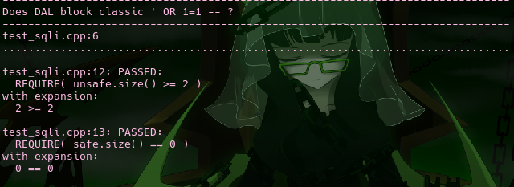
Test 1 — Does the DAL block the classic ' OR 1=1 -- tautology?
Vulnerability: SQL Injection (STD-003, STD-001)
Payload: username = ' OR 1=1 --
Expected: Unsafe concat would broaden results; safe param query returns 0.
Observed (from run):
unsafe.size() >= 2 → 2 >= 2 (passed)
safe.size() == 0 → 0 == 0 (passed)

Slide 10
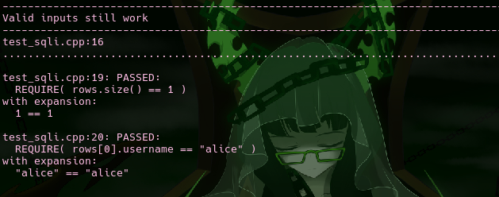
Test 2 — Are valid inputs still returned correctly?
Vulnerability: False positives avoidance (STD-003, STD-001)
Input: username = "alice"
Expected: Exactly 1 row; correct username.
Observed:
rows.size() == 1 → 1 == 1 (passed)
rows[0].username == "alice" → "alice" == "alice" (passed)

Slide 11
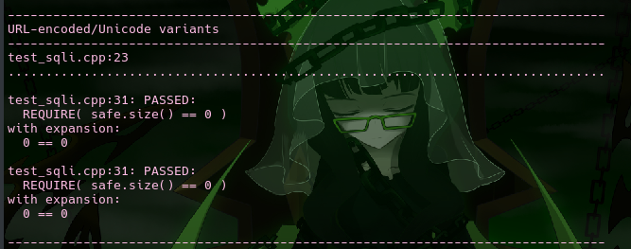
Test 3 — Do URL-encoded/Unicode variants bypass defenses?
Vulnerability: Canonicalization bypass (STD-003, STD-001)
Payloads: %27%20OR%201%3D1%20-- and ＇ OR １＝１ --
Expected: Treated as literals; 0 rows.
Observed:
safe.size() == 0 → 0 == 0 (passed) (twice)

Slide 12
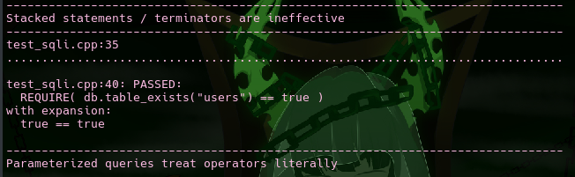
Test 4 — Are stacked statements / terminators blocked?
Vulnerability: Stacked query attempt (STD-003, STD-005)
Payload: '; DROP TABLE users; --
Expected: No schema changes; table still exists.
Observed:
db.table_exists("users") == true → true == true (passed)

Slide 13
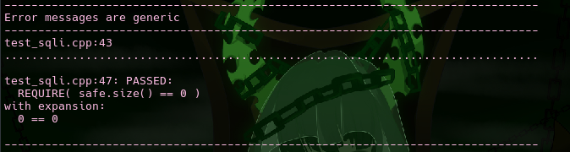
Test 5 — Are error messages generic (no SQL/system details)?
Vulnerability: Information disclosure (STD-005)
Setup: Oversized/bad input; check no sensitive detail returns to user.
Expected: Generic user message; sanitized internals; result set 0.
Observed:
safe.size() == 0 → 0 == 0 (passed)

Slide 14
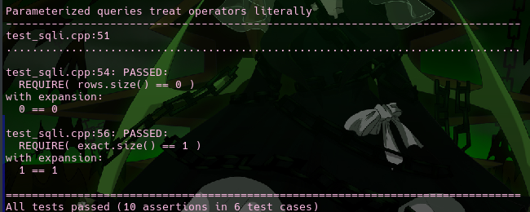
Test 6 — Do parameterized queries treat operators literally?
Vulnerability: Operator injection in a field (STD-003)
Payload: victim@example.com' OR 'x'='x
Expected: Treated literally; 0 rows; exact email still returns 1.
Observed:
rows.size() == 0 → 0 == 0 (passed)
exact.size() == 1 → 1 == 1 (passed)

Slide 15
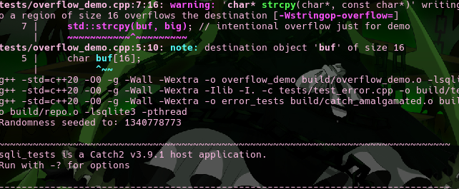
Demo A — Compiler flags a stack buffer overflow
Vulnerability: Buffer overflow (STD-002)
Code: tests/overflow_demo.cpp uses strcpy into char buf[16].
Observed at build:
warning: 'strcpy' writing 33 bytes into a region of size 16 [-Wstringop-overflow=]

Slide 16
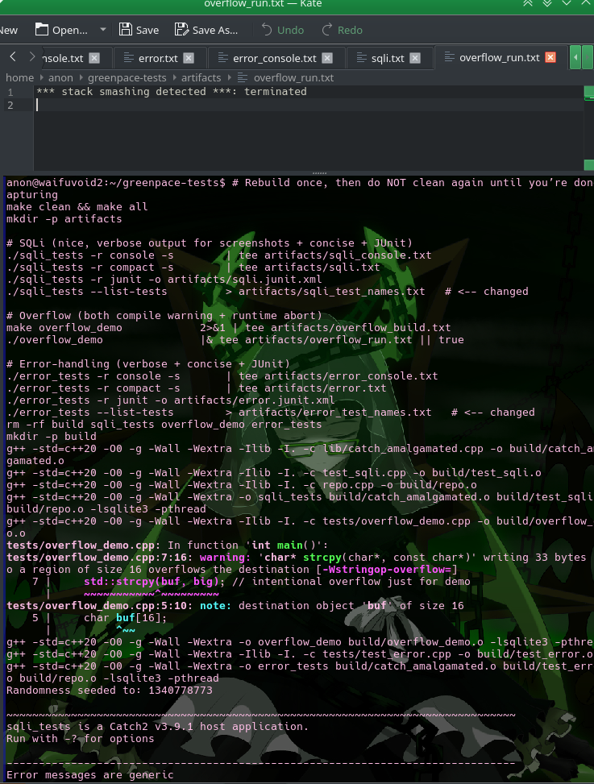
Demo B — Runtime protection detects stack smashing
Run: ./overflow_demo
Observed at runtime: *** stack smashing detected ***: terminated

Slide 17
Results Summary
Error Handling & No Info-Leak
Test: Safe copy truncates oversized input
Observed: out.size() == 15 → 15 == 15 (passed)
Test: Exceptions don’t leak sensitive details
Observed: public text contains “Something went wrong”; internal text [sanitized] (both asserts passed)
How we applied the unit test framework
Framework: Catch2 v3 (header + catch_amalgamated.cpp)
Pattern: One test per attack question; assertions verify both positive and negative paths.
Run options: -r console -s for readable output; -r junit to export CI artifacts.
Automation hook: Add make all && ./sqli_tests && ./error_tests to CI (pre-merge gate).
Extendability: Add fuzz inputs, property-based cases, and DB-driver matrix (SQLite/MySQL/Postgres). SQL Injection: 6/6 tests passed; unsafe path demonstrated; safe path blocked all variants.
Memory Safety: Compiler warning + runtime abort prove external defenses active.
Error Handling: 2/2 tests passed; no sensitive detail exposed.
Artifacts: Stored at ~/greenpace-tests/artifacts/ for auditing.

Slide 18

AUTOMATION SUMMARY

Slide 19
AUTOMATION SUMMARY
Flow: Dev (pre-commit) → CI Build/Test → SAST/SCA → Package (SBOM+Sign) → IaC Policy → DAST (Preview) → Deploy (Gates) → Runtime (Monitor)
Pre-commit (Dev): secret scan, lint/format, quick unit tests → block commit on secret/leak.
CI Build & Unit Tests (PR): compiler runs here (-Wall -Wextra -Werror, stack protector, PIE/RELRO) + Catch2 tests → fail PR on any warning/test failure.
SAST & SCA (PR): CodeQL/Semgrep + dep scan (Trivy/OWASP-DC) → block on High/Critical.
Package (post-merge): build image, create SBOM (Syft), image scan (Trivy/Grype), sign (Cosign), provenance (SLSA) → block unsigned/vulnerable images.
IaC / Policy (PR): Terraform/K8s checks (Checkov/Conftest/OPA) → deny risky configs (e.g., public S3, privileged pods).
DAST in Preview (pre-prod): OWASP ZAP baseline/auth → halt promotion on new High/Critical.
Deploy (staging→prod): admission controller enforces signatures/policies; canary/blue-green with auto-rollback on health/SLO breach.
Runtime: central logs/metrics/traces → SIEM alerts; scheduled rescans + Renovate PRs keep deps current.

Slide 20
Evidence
sqli_console.txt, error_console.txt, overflow_build.txt, overflow_run.txt included in submission Evidence from this project:
sqli_console.txt & error_console.txt → CI test proof (unit tests).
overflow_build.txt → Compiler warned on buffer overflow.
overflow_run.txt → Runtime stack protector caught corruption.
(These artifacts are exactly what you’d attach to the CI job for auditability.)

Slide 21
TOOLS
Flow: Dev (pre-commit) → CI Build/Test → SAST & SCA → Package (SBOM & Sign) → IaC Policy Checks → DAST in Preview → Deploy (Gates) → Runtime (Monitor & Learn)
Pre-commit (Developer laptop): Fast feedback before code leaves the machine—secret scan, lint/format, and a small unit-test subset. Blocks obvious issues early.
CI Build/Test (on every PR): Compiler with strict flags and unit tests run on clean infrastructure. Any warning/test failure fails the PR. This produces trusted, repeatable evidence (logs, JUnit).
SAST & SCA: Code is statically analyzed for taint/injection patterns; dependencies are checked for known CVEs. High/Critical issues block merge unless risk-accepted.
Package, SBOM, Signing: Build container/binary, generate SBOM, scan the artifact, and sign it. Only signed, policy-compliant artifacts proceed.
IaC Policy Checks: Terraform/K8s manifests are scanned against guardrails (least privilege, no public buckets, no privileged pods). Violations block.
DAST in Ephemeral Preview: Spin up a short-lived env; run active/baseline web scans (including auth flows). New High/Critical findings halt promotion.
Deploy with Admission Gates: Admission controller verifies image signatures and policies. Canary/blue-green rollout with auto-rollback on health/SLO breaches.
Runtime Monitoring & Feedback: Centralized logs/metrics/traces feed alerts (auth anomalies, error spikes). Scheduled rescans and automated dependency updates keep posture current. Findings loop back into backlog and policies.

Slide 22
TOOLS
Pre-commit (Dev): Gitleaks (secrets), clang-format/cpplint, small Catch2 test shard. Gate: commit rejected on secret/leak or failing tests.
CI Build/Test (PR): Compiler: -Wall -Wextra -Werror, stack protector, PIE/RELRO. Unit tests: Catch2 (your sqli_tests, error_tests), SQLite in-memory for DAL tests. Artifacts: console + JUnit logs (your artifacts/*.txt, *.xml). Gate: any warning or test failure fails PR.
SAST & SCA (PR): CodeQL or Semgrep (SAST), Trivy or OWASP Dependency-Check (SCA). Gate: High/Critical findings block merge (or require documented exception).
Package / SBOM / Sign (post-merge): Syft (SBOM), Grype/Trivy (image scan), Cosign (signing), SLSA provenance. Gate: unsigned image or Critical vuln → publish denied.
IaC Policy (PR): Checkov, Conftest/OPA Gatekeeper for Terraform/K8s. Gate: policy violations (public S3, wildcard roles, privileged pods) block.
DAST (Preview env): OWASP ZAP (baseline/auth scan), optional Nikto/Nuclei for targeted checks. Gate: new High/Critical alerts stop promotion.
Deploy (staging→prod): Kubernetes Admission Controller (verify Cosign signatures, OPA policies), Argo Rollouts/Flagger for canary/blue-green. Gate: unsigned or non-compliant images are denied.
Runtime & Feedback: ELK/Splunk (logs), Prometheus/Grafana (metrics), OpenTelemetry (traces), Falco (runtime security). Scheduled registry rescans + Renovate PRs for dependency updates. Action: alerts create tickets; patterns feed back into tests/policies.

Slide 23
RISKS
If we wait
Active exploit window for SQLi/overflow/info-leak; higher breach probability.
Compounding technical debt; retrofit cost/time rises.
Regulatory & contractual exposure (fines, audit findings, lost deals).
Longer incident MTTR due to missing CI evidence and weak telemetry.
Risks of this strategy (when implemented)
Pipeline friction: slower merges if gates are too strict; false positives create alert fatigue.
Tool sprawl & cost; ownership gaps across teams.
Single points of failure in signing/provenance infra (Cosign/SLSA) if not HA.
Preview/ephemeral envs expand attack surface if not isolated and auto-torn down.
Centralized logs/trace data can hold sensitive info if PII filtering/retention isn’t enforced.
Over-reliance on scanners → logic/authorization bugs may still slip through.
Where the strategy is still lacking (gaps)
Infrequent threat modeling/abuse-case reviews per service.
Limited AuthZ depth tests (role/tenant isolation) in CI.
Sparse fuzz/property testing on parsers and input heavy code.
Secrets lifecycle not fully automated (rotation/broker/access).
IR runbooks, backup/restore drills not yet routine.

Slide 24
Benefits
Security & engineering outcomes
Immediate reduction of high-impact risks (SQLi, overflow, info-leak) via tests + compiler guards.
Consistent defenses: param queries, sanitized errors, IaC guardrails, signed artifacts.
Faster, reproducible investigations (JUnit logs, SBOMs, scan reports, provenance).
Fewer hotfixes; earlier defect removal lowers rework costs.
Operational & business value
Compliance uplift (evidence on every PR/release); better audit readiness.
Safer deployments: admission policies, progressive rollouts, auto-rollback.
Higher developer confidence and clearer “definition of done.”
Improved stakeholder trust and reduced downtime/incident costs.
Quick wins (next 30 days)
Make compiler warnings fatal; enforce parameterized queries org-wide.
Turn on SAST/SCA + IaC checks with block on High/Critical severities.
Generate SBOMs, scan images, sign artifacts; enable admission verification.
Standardize generic error handler and log sanitization.
Add pre-commit secret scanning; rotate any exposed secrets.

Slide 25
RECOMMENDATIONS
Governance & Risk
No formal risk-acceptance workflow, remediation SLAs, or complete asset inventory.
Third-party/vendor risk and license compliance not defined.
Application Security
Standards focus on SQLi/overflow only; missing XSS/CSRF/SSRF/path traversal/deserialization/XXE/command injection.
Lacks output encoding/CSP, secure file handling, and secrets-in-code rules.
Identity & Access (AAA)
MFA not enforced everywhere; session/token lifetime & rotation unspecified.
Least privilege/SoD and periodic access reviews absent.
Service-to-service auth & mTLS/JWT validation (aud/iss/exp/kid/rotation) not standardized.
Data Protection
No data classification; weak detail on encryption in use (field-level/TEE).
KMS/HSM, key rotation, backup encryption/access not mandated.
Infrastructure & Cloud
No baseline hardening (CIS), drift detection, or network egress controls.
Container runtime policies (seccomp/AppArmor, read-only FS, non-root) not required.
WAF/rate limiting/bot defense not specified.
Supply Chain
SBOM and artifact signing/verification not mandated across all services.
No dependency update cadence (Renovate) or SLSA/provenance level target.
Testing & Automation
Missing DAST coverage for auth flows, fuzz/property tests, and coverage targets.
Secrets scanning not enforced pre-commit/PR; no perf/security regression gates.
Observability & IR
PII log scrubbing, log retention, alert thresholds, IR runbooks, and DR/backups RTO/RPO drills not defined.
Privacy & Compliance
Data residency/retention and data subject rights processes not captured.
People & Process
No cadence for secure-coding training, threat modeling workshops, or security champions; code-review security checklist missing.

Slide 26
CONCLUSIONS
Secure SDLC & Governance
NIST SSDF (SP 800-218) – baseline secure-dev practices; make them PR acceptance criteria.
OWASP SAMM – program maturity model; set quarterly targets.
ISO/IEC 27001/27002 – map policies/controls; align audits to Annex A.
Application & Code
OWASP ASVS 4.x + OWASP API Security Top 10 (2023) – make these your functional security acceptance tests.
CWE Top 25 tracking in backlog; fail PRs introducing listed CWEs.
SEI CERT C++ + C++ Core Guidelines – ban unsafe C APIs (e.g., strcpy, sprintf) and enforce via linters/CI.
Compiler/Sanitizers standard – -Wall -Wextra -Werror -fstack-protector-strong -D_FORTIFY_SOURCE=3 -fPIE -pie (+ ASan/UBSan in CI where supported).
Identity (AAA)
NIST SP 800-63B – MFA, password, session/token requirements.
OAuth 2.1 + OpenID Connect – standardized user/service auth; WebAuthn/FIDO2 for admins.
Cryptography
TLS 1.3 / IETF BCP 195 – strong cipher suites; HSTS.
NIST SP 800-57 (key mgmt) + FIPS 140-3 validated crypto modules.
mTLS for service-to-service; envelope encryption via KMS/HSM.
Data Protection
Data Classification Standard (Public / Internal / Confidential / Restricted) with required controls per class.
Retention & Disposal policy; encrypted backups; quarterly restore drills.
Cloud / Infra / Kubernetes
CIS Benchmarks (OS, Docker, Kubernetes, cloud provider) + NSA/CISA K8s Hardening.
K8s Pod Security Standards (baseline → restricted); non-root, read-only rootfs, seccomp/AppArmor.
OPA/Gatekeeper (policy-as-code) for cluster/IaC enforcement.
IaC & Policy
Terraform module standards + Conftest/OPA checks in PRs; drift detection required.
Supply Chain Security
SLSA v1.0 (Level ≥3) – provenance + hermetic builds.
NIST SP 800-161 (supplier risk) + OpenSSF Scorecard (repo hygiene).
SBOM in SPDX/CycloneDX; VEX for vuln exceptions.
SCA (Trivy/OWASP DC) with SLAs; Renovate for automated updates.
Testing & Scanning
SAST (CodeQL/Semgrep), DAST (OWASP ZAP incl. auth), fuzzing (libFuzzer/AFL), property-based tests.
Secrets scanning (Gitleaks) pre-commit/PR.
Logging, Monitoring, IR
OpenTelemetry (logs/metrics/traces) with PII redaction standard.
NIST SP 800-92 (log mgmt), MITRE ATT&CK mapping for detections.
NIST SP 800-61 (incident response) + SP 800-34 (contingency planning).

Slide 27
REFERENCES
Secure SDLC & Governance National Institute of Standards and Technology. (2022). Secure Software Development Framework (SSDF) v1.1 (NIST SP 800-218). https://doi.org/10.6028/NIST.SP.800-218 OWASP Foundation. (2023). OWASP Software Assurance Maturity Model (SAMM) v2.1. https://owaspsamm.org International Organization for Standardization. (2022). ISO/IEC 27001:2022. https://www.iso.org/standard/82875.html International Organization for Standardization. (2022). ISO/IEC 27002:2022. https://www.iso.org/standard/75652.html
Application & Code OWASP Foundation. (2021). Application Security Verification Standard (ASVS) v4.0.3. https://owasp.org/www-project-application-security-verification-standard OWASP Foundation. (2023). OWASP API Security Top 10 – 2023. https://owasp.org/API-Security/ MITRE. (2024). CWE Top 25 Most Dangerous Software Weaknesses. https://cwe.mitre.org/top25/ Carnegie Mellon University, Software Engineering Institute. (n.d.). SEI CERT C++ Coding Standard. https://wiki.sei.cmu.edu/confluence/display/cplusplus Stroustrup, B., Sutter, H., & contributors. (n.d.). C++ Core Guidelines. https://isocpp.github.io/CppCoreGuidelines/ Free Software Foundation. (n.d.). GCC online docs (warning options). https://gcc.gnu.org/onlinedocs/gcc/ LLVM Project. (n.d.). AddressSanitizer & UndefinedBehaviorSanitizer. https://clang.llvm.org/docs/
Identity (AAA) National Institute of Standards and Technology. (2017). Digital Identity Guidelines (NIST SP 800-63B). https://doi.org/10.6028/NIST.SP.800-63b IETF OAuth Working Group. (n.d.). OAuth 2.1 (Internet-Draft). https://datatracker.ietf.org/doc/draft-ietf-oauth-v2-1/ OpenID Foundation. (2014/2021). OpenID Connect Core 1.0. https://openid.net/specs/openid-connect-core-1_0.html World Wide Web Consortium. (2023). Web Authentication (WebAuthn) L3 (WD). https://www.w3.org/TR/webauthn-3/
Cryptography IETF. (2018). TLS 1.3 (RFC 8446). https://www.rfc-editor.org/rfc/rfc8446 IETF. (2023). BCP 195: Recommendations for Secure Use of TLS/DTLS (RFC 9325). https://www.rfc-editor.org/rfc/rfc9325 IETF. (2012). HTTP Strict Transport Security (RFC 6797). https://www.rfc-editor.org/rfc/rfc6797 National Institute of Standards and Technology. (2020). Recommendation for Key Management, Pt.1 Rev.5 (NIST SP 800-57). https://csrc.nist.gov/pubs/sp/800/57/pt1/r5/final National Institute of Standards and Technology. (2019). FIPS 140-3: Security Requirements for Cryptographic Modules. https://doi.org/10.6028/NIST.FIPS.140-3
Cloud / Infra / Kubernetes & IaC Center for Internet Security. (n.d.). CIS Benchmarks. https://www.cisecurity.org/cis-benchmarks/ NSA & CISA. (2023). Kubernetes Hardening Guide v1.3. https://media.defense.gov/…/CTR_KUBERNETES_HARDENING_GUIDE_1.3.PDF Kubernetes Project. (n.d.). Pod Security Standards. https://kubernetes.io/docs/concepts/security/pod-security-standards/ Open Policy Agent. (n.d.). Gatekeeper; Conftest. https://open-policy-agent.github.io/gatekeeper/ ; https://www.conftest.dev/ HashiCorp. (n.d.). Terraform module best practices. https://developer.hashicorp.com/terraform/language/modules/develop
Supply Chain Security SLSA Community. (2023). SLSA v1.0: Supply-chain Levels for Software Artifacts. https://slsa.dev/spec/v1.0/ National Institute of Standards and Technology. (2022). Cybersecurity Supply Chain Risk Management (NIST SP 800-161 Rev.1). https://doi.org/10.6028/NIST.SP.800-161r1 OpenSSF. (n.d.). Scorecard. https://github.com/ossf/scorecard SPDX Workgroup. (2024). SPDX Specification. https://spdx.dev/specifications/ ; CycloneDX. (n.d.). Specification. https://cyclonedx.org/specification/ OASIS / CISA. (2022). CSAF 2.0 & VEX Guidance. https://docs.oasis-open.org/csaf/… ; https://www.cisa.gov/resources-tools/resources/vex
Testing, Secrets, Logging & IR GitHub. (n.d.). CodeQL documentation. https://codeql.github.com/docs/ ; Semgrep. (n.d.). Docs. https://semgrep.dev/learn ; OWASP. (n.d.). ZAP docs. https://www.zaproxy.org/docs/ Gitleaks. (n.d.). Find secrets in code. https://github.com/gitleaks/gitleaks OpenTelemetry. (n.d.). Specs for logs/metrics/traces. https://opentelemetry.io/docs/specs/ National Institute of Standards and Technology. (2006). Guide to Computer Security Log Management (NIST SP 800-92). https://csrc.nist.gov/pubs/sp/800/92/final MITRE. (n.d.). ATT&CK® framework. https://attack.mitre.org/ National Institute of Standards and Technology. (2012). Computer Security Incident Handling Guide (NIST SP 800-61 Rev.2). https://csrc.nist.gov/pubs/sp/800/61/r2/final National Institute of Standards and Technology. (2012). Contingency Planning Guide (NIST SP 800-34 Rev.1). https://csrc.nist.gov/pubs/sp/800/34/r1/upd1/final

